Slide 1
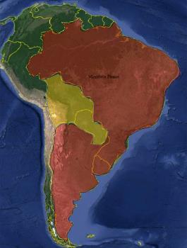
11th MEETING OF THE IHO INTER-REGIONAL COORDINATING COMMITTEE
IHO-IRCC 11
Genoa, Italia, 3-5 June 2019
South West Atlantic Hydrographic Commission (SWAtHC) Report
In 2006, Argentine, Brazil and Uruguay signed the cooperation agreement that result in the South West Atlantic Hydrographic Commission (SWAtHC). Main achievements have been the development of a regional Cartographic Plan, establishment of a Planning Commission to coordinate INT Charts and ENC production and the acceptance of Bolivia and Paraguay as Observer and Associate Members.

Slide 2
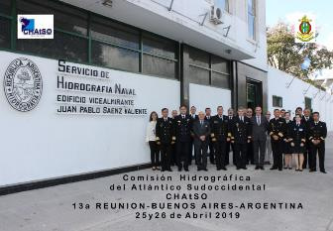
11th MEETING OF THE IHO INTER-REGIONAL COORDINATING COMMITTEE
IHO-IRCC 11
Genoa, Italia, 3-5 June 2019
Chair: Captain Pablo TABAREZ (Uruguay)
Vice-Chair: Commodore Valentin Alejandro SANZ RODRIGUEZ (Argentina)
Full Members: Argentina, Brazil and Uruguay.
Associate members: Paraguay.
Observers: Bolivia (presenting membership request as associate member)
Last Meeting: SWAtHC 13 took place at Hydrographic Service of Argentinian Navy (SHN), Buenos Aires Argentina (25-26 April, 2019)
Next meeting: will be held in Niteroi, Brazil (5-6 March 2020)
Photo at SHN

Slide 3
11th MEETING OF THE IHO INTER-REGIONAL COORDINATING COMMITTEE
IHO-IRCC 11
Genoa, Italia, 3-5 June 2019
South West Atlantic Hydrographic Commission (SWAtHC) Report Key achievements
The full members has approved the request of The Hydrographic National Service of Bolivia Navy, and start the procedure of adhesion to became as an Associate Member of SWAtHC. That Service should address this to its national authorities

Slide 4
11th MEETING OF THE IHO INTER-REGIONAL COORDINATING COMMITTEE
IHO-IRCC 11
Genoa, Italia, 3-5 June 2019
South West Atlantic Hydrographic Commission (SWAtHC) Report
Capacity Building
Activities Completed on 2018
Maritime Safety Information – MSI (DHN-Brazil)
Workshop of Harbour and Shallow Water Surveys (SHN-Argentina)
Workshop of LIDAR Surveys (SEPRHC, INOCAR-Ecuador)
Workshop of Data Multibeam Processing (MACHC, CIOH-Colombia)

Slide 5
11th MEETING OF THE IHO INTER-REGIONAL COORDINATING COMMITTEE
IHO-IRCC 11
Genoa, Italia, 3-5 June 2019
Main items under consideration:
SWAtHC INT Chart scheme has a total of 44 charts. From these, 34 charts (77.2%) have already been published.
COUNTRY | INT CHARTS PLANNED | INT CHARTS AVAILABLE | PERCENTAGE
ARGENTINA | 9 | 2 | 22%
BRAZIL | 32 | 32 | 100%
URUGUAY | 1 | 0 | 0%
JOINT ARG/UY | 2 | 0 | 0%
TOTAL | 44 | 34 | 77.2%

Slide 6
11th MEETING OF THE IHO INTER-REGIONAL COORDINATING COMMITTEE
IHO-IRCC 11
Genoa, Italia, 3-5 June 2019
Main items under consideration:
SWAtHC ENC scheme has a total of 245 cells. From these, 193 cells (78 %) have already been released.
COUNTRY | ENCs PLANNED | ENCs AVAILABLE | PERCENTAGE
BRAZIL | 120 | 103 | 86%
ARGENTINA | 64 | 60 | 94 %
URUGUAY | 61 | 30 | 49.2%
TOTAL | 245 | 193 | 78%
The end result is that the region has no significant overlaps, no unassessed CATZOCs and gaps are being addressed.

Slide 7
11th MEETING OF THE IHO INTER-REGIONAL COORDINATING COMMITTEE
IHO-IRCC 11
Genoa, Italia, 3-5 June 2019
South West Atlantic Hydrographic Commission (SWAtHC) Report
Conclusions
SWAtHC is committed to carrying out forward hydrographic, cartographic and capacity building activities in a straight alignment with IHO objectives and goals. In addition, SWAtHC join efforts to coordinate nautical charts and ENCs production, harmonizing boundaries.
Action Required of IRCC10 : refer to full report for status of IRCC actions relevant to SWAtHC Chair

